Slide 1
Lesson: Control-Statements

Slide 2
Control-Statements
Java compiler executes the code from top to bottom
Statements that can be used to control the flow of Java code.
The statements which breaks the normal sequential flow of the program are called control statements.
Java provides three types of control flow statements.
Decision Making statements
if statements
switch statement
Loop statements
do while loop
while loop
for loop
for-each loop
Jump statements
break statement
continue statement

Slide 3
Java Operators
Operator Type | Category | Precedence
Unary | postfix | expr++ expr--
 | prefix | ++expr --expr +expr -expr ~ !
Arithmetic | multiplicative | * / %
 | additive | + -
Shift | shift | << >> >>>
Relational | comparison | < > <= >= instanceof
 | equality | == !=
Bitwise | bitwise AND | &
 | bitwise exclusive OR | ^
 | bitwise inclusive OR | |
Logical | logical AND | &&
 | logical OR | ||
Ternary | ternary | ? :
Assignment | assignment | = += -= *= /= %= &= ^= |= <<= >>= >>>=

Slide 4
Conditional Operators
Types of Conditional Operator
There are three types of the conditional operator in Java:
Conditional AND (&&)
Conditional OR(||)
Ternary Operator

Slide 5
Conditional AND (&&)
This operator is applied between two Boolean expressions.
It is denoted by the two AND operators (&&).
It returns true if and only if both expressions are true, else returns false.
Expression1 | Expression2 | Expression1 && Expression2
True | False | False
False | True | False
False | False | False
True | True | True

Slide 6
Conditional OR (||)
The operator is applied between two Boolean expressions.
It is denoted by the two OR operator (||).
It returns true if any of the expression is true, else returns false.
Expression1 | Expression2 | Expression1 && Expression2
True | False | True
False | True | True
False | False | False
True | True | True

Slide 7
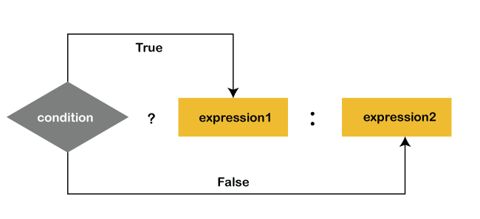
Ternary Operator(?:)
The meaning of ternary is composed of three parts. The ternary operator (? :) consists of three operands
It is used to evaluate Boolean expressions.
The operator decides which value will be assigned to the variable.
It is the only conditional operator that accepts three operands.
Syntax:
variable = (condition) ? expression1 : expression2)

Slide 8
Decision making statements: If, if-else, switch
If:
-It evaluates a Boolean expression and enables the program to enter a block of code if the expression evaluates to true.
Syntax:
if(condition) {
statement 1; //executes when condition is true
}
if-else statement:
-The else block is executed if the condition of the if-block is evaluated as false
Syntax:
if(condition) {
statement 1; //executes when condition is true
}
else{
statement 2; //executes when condition is false
}

Slide 9
Decision making statements: If, if-else, switch
Nested If:
Syntax:
if(condition 1) {
statement 1; //executes when condition 1 is true
if(condition 2) {
statement 2; //executes when condition 2 is true
}
else{
statement 2; //executes when condition 2 is false
}
}

Slide 10
Switch:
The case variables can be int, short, byte, char, or enumeration. String type is also supported since version 7 of Java
Cases cannot be duplicate
Default statement is executed when any of the case doesn't match the value of expression. It is optional.
Break statement terminates the switch block when the condition is satisfied.
While using switch statements, we must notice that the case expression will be of the same type as the variable.
Syntax: switch (expression){
case value1:
statement1;
break;
case valueN:
statementN;
break;
default:
default statement; }

Slide 11
Switch:
The case variables can be int, short, byte, char, or enumeration. String type is also supported since version 7 of Java
Cases cannot be duplicate
Default statement is executed when any of the case doesn't match the value of expression. It is optional.
Break statement terminates the switch block when the condition is satisfied.
While using switch statements, we must notice that the case expression will be of the same type as the variable.
Syntax: switch (expression){
case value1:
statement1;
break;
case valueN:
statementN;
break;
default:
default statement; }

Slide 12
Thank You!! We will Continue with Looping Statements

